Slide 1
Controlando o fluxo

Slide 2
Lock
Travado ou destravado
Primitivas
acquire
release
RuntimeError se tentar liberar algo que não foi adquirido

Slide 3
Lock
from threading import Lock, Thread
lock = Lock()
g = 0
def add_one():
global g
lock.acquire()
g += 1
lock.release()

Slide 4
RLock
Travado ou destravado – mas sabe quem adquiriu o Lock
Primitivas
acquire
release
RuntimeError se tentar liberar algo que não foi adquirido

Slide 5
RLock
lock = Threading.RLock()
lock.acquire()
num += 3
lock.acquire()
num += 4
lock.release()
lock.release()
lock.acquire()
num += 3
lock.acquire()
num += 4
lock.release()
lock.release()

Slide 6
Semaphore
Limitar um recurso no servidor
Controla o número de clientes que podem adquir algo

Slide 7
Semaphore
import random, time
from threading import BoundedSemaphore, Thread
max_items = 5
container = BoundedSemaphore(max_items)
def producer(nloops):
for i in range(nloops):
time.sleep(random.randrange(2, 5))
print(time.ctime(), end=": ")
try:
container.release()
print("Produced an item.")
except ValueError:
print("Full, skipping.")

Slide 8
Event
Aguardar por um evento
Lançar o evento
Primitivas
set
wait
clear

Slide 9
import random, time
from threading import Event, Thread
event = Event()
def waiter(event, nloops):
for i in range(nloops):
print(“%s. Waiting for the flag to be set.” % (i+1))
event.wait() # Blocks until the flag becomes true.
print(“Wait complete at:”, time.ctime())
event.clear() # Resets the flag.
print()
def setter(event, nloops):
for i in range(nloops):
time.sleep(random.randrange(2, 5)) # Sleeps for some time.
event.set()

Slide 10


Slide 11
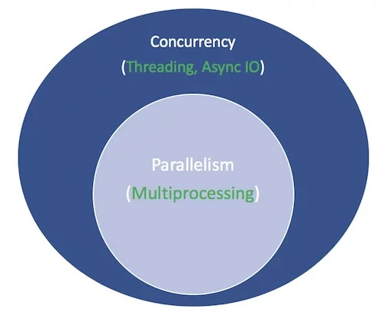

Slide 12
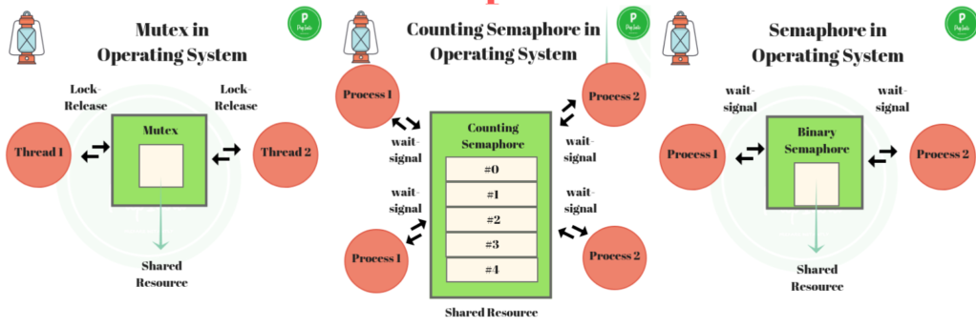
Semaphore vs Mutex

Slide 13
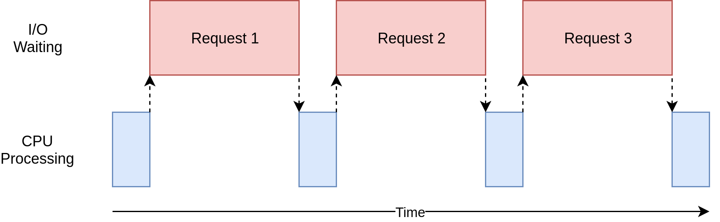
IO Bound

Slide 14
https://hackernoon.com/synchronization-primitives-in-python-564f89fee732
https://prepinsta.com/wp-content/uploads/2019/01/Mutex-Vs-Semaphore-1-1024x429.png

